Slide 1



NHSN FHIR dQMs: Process Flow from EHR to NHSN
Facility
NHSNLink identifies patients of interest from EHR*
NHSNLink queries EHR to identify data elements required to calculate measures (e.g., medications, labs) for patients of interest
NHSN application runs algorithms to determine if patient meets measure denominator and numerator criteria. Analytics performed and measure reports available for NHSN users.
NHSN connects securely to facility
Data further validated and analyzed
*Patients in emergency department, observation, or inpatient location or status during the measurement period.

Slide 2
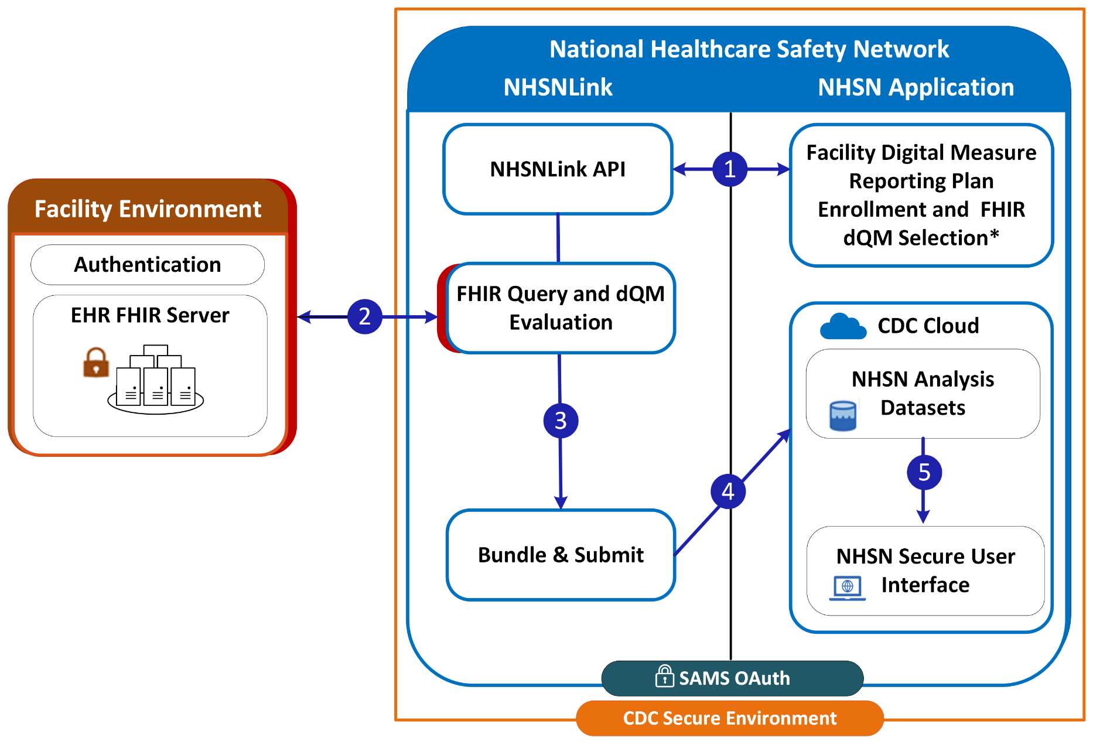

NHSNLink: How It Works
Confirm facility enrollment in digital measure reporting plan; request and receive NHSN FHIR dQM
Request and receive Patients of Interest and query data defined by dQM
Evaluate and filter data as defined by dQM
Submit MeasureReport bundle for patients meeting dQM definition
NHSN ingests and analyzes MeasureReport bundles and makes reports available via secure NHSN user interface
*Signals facility readiness to report digital quality measure and that facility has signed NHSN data-use agreements for secure data-sharing, including “NHSN Agreement to Participate and Consent” and “NHSN Facility/Group User & Administrator Rules of Behavior.”
API: Application Programing Interface; CDC, Centers for Disease Control and Prevention; dQM: digital quality measure; EHR: Electronic health record; FHIR: Fast Healthcare Interoperability Resources; NHSN: National Healthcare Safety Network; SAMS: Secure Access Management Services
Notes:
Source document: NHSNLink Data Flow Simple_2.2024.vsdx

